Slide 1
Part 3: Production Deployment
Building Conversational AI Applications

Slide 2
Course Timeline
8:50 | — | 9:00 |  | Welcome
9:00 | — | 10:00 |  | Lecture 1
10:00 | — | 11:00 |  | Lab 1
11:00 | — | 11:15 |  | Break
11:15 | — | 12:15 |  | Lecture 2
12:15 | — | 13:15 |  | Lab 2
13:15 | — | 14:00 |  | break
14:00 | — | 15:00 |  | Lecture 3
15:00 | — | 16:00 |  | Lab 3
16:00 | — | 17:00 |  | Assessment support
Notes:
To change according to the agenda, time zone ..
Minimum 2 breaks per day. Minimum 30mn per lab
Minimum 30mn for assessment

Slide 3
Course Agenda
Part 1: ASR - Automatic Speech Recognition Lecture: Challenges of conversational AI applications, building blocks, ASR (automatic speech recognition) focus Lab: Investigate ASR pipeline with NeMo and Riva
Part 2: TTS – Text To Speech and Conversational AI Customization Lecture: How can we take advantage of conversational AI platforms to build custom applications? Lab: Investigate the TTS pipeline with NeMo and Riva; then build a full custom conversational AI pipeline.
Part 3: Production Deployment Lecture: Discussion of production deployment considerations including an overview of NVIDIA Triton Inference Server and TensorRT. Lab: Hands-on deployment of an example application using Helm and Kubernetes; includes profiling the application.

Slide 4
Part 1
Deploy (Part 3)
Lecture
Beyond Model Accuracy, Meeting Application Requirements
The Right Model
The Right Implementation
Model Optimization Techniques
Beyond a Single Model
Real-World Applications
Lab
Making Kubernetes GPU-Aware
First GPU-Accelerated Application
Monitoring Your GPUs
Deploying Riva
Using Riva

Slide 5


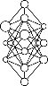

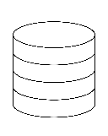
AI Deep Learning Inference Workflow
Two-part process implemented by multiple personas
Data Scientist | ML Engineer
ML Engineer
Model Optimization
Trained
Models
Optimize For Multiple Constraints For High Perf. Inference
MLOps, DevOps
App Developer
Query
Inference Serving
AI Application
Result
Scaled Multi-framework Inference Serving For High Perf. & Utilization On GPU/CPU
Model
Store

Slide 6
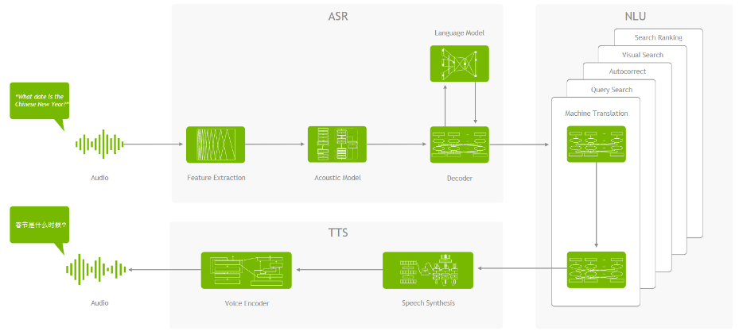
Beyond Model Accuracy
They do not live in isolation

Slide 7
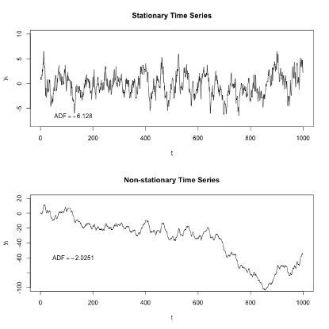
Beyond Model Accuracy
And they need to evolve over time
https://en.wikipedia.org/wiki/Stationary_process

Slide 8
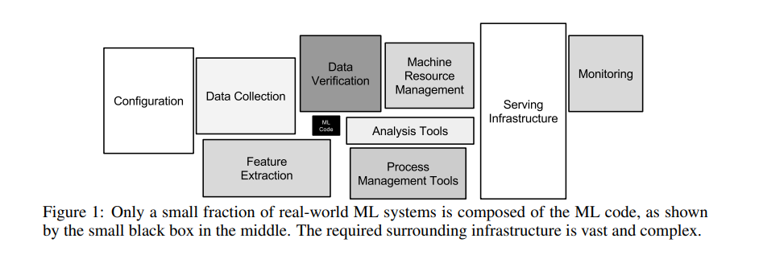
Beyond Model Accuracy
Complexity of real-world applications
Sculley, D., Holt, G., Golovin, D., Davydov, E., Phillips, T., Ebner, D., ... & Dennison, D. (2015). Hidden technical debt in machine learning systems. In Advances in neural information processing systems (pp. 2503-2511).

Slide 9
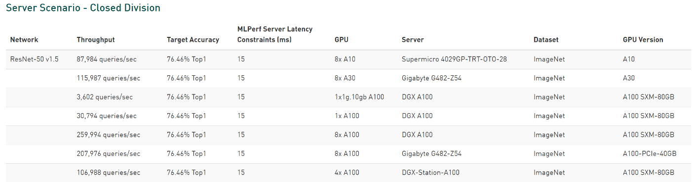
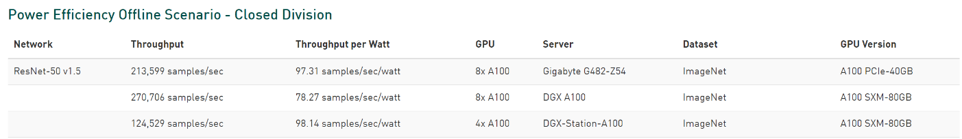
Beyond Model Accuracy
The trade-off | accuracy - latency – throughput – power efficiency
https://developer.nvidia.com/deep-learning-performance-training-inference

Slide 10
Part 1
Deploy (Part 3)
Lecture
Beyond Model Accuracy, Meeting Application Requirements
The Right Model
The Right Implementation
Model Optimization Techniques
Beyond a Single Model
Real-World Applications
Lab
Making Kubernetes GPU-Aware
First GPU-Accelerated Application
Monitoring Your GPUs
Deploying Riva
Using Riva
Notes:
Choosing the right model that meets the requirement

Slide 11
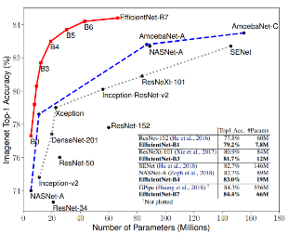
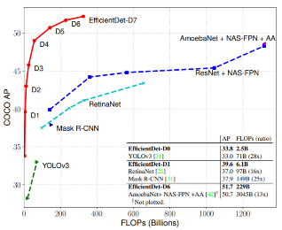
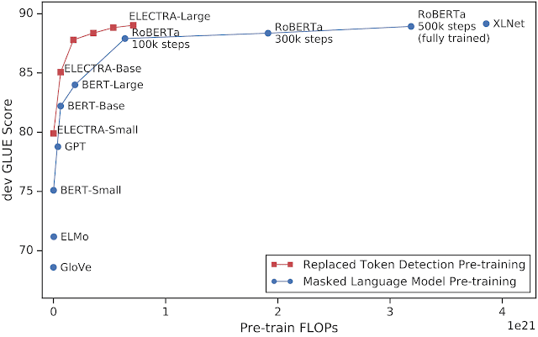
Model Selection
Not all models are created equal
Image Classification
Object detection
NLP
Kevin Clark and Minh-Thang Luong and Quoc V. Le and Christopher D. Manning. ELECTRA: Pre-training Text Encoders as Discriminators Rather Than Generators. ICLR 2020
Mingxing Tan and Quoc V. Le “EfficientNet: Rethinking Model Scaling for Convolutional Neural Networks”. ICML 2019

Slide 12
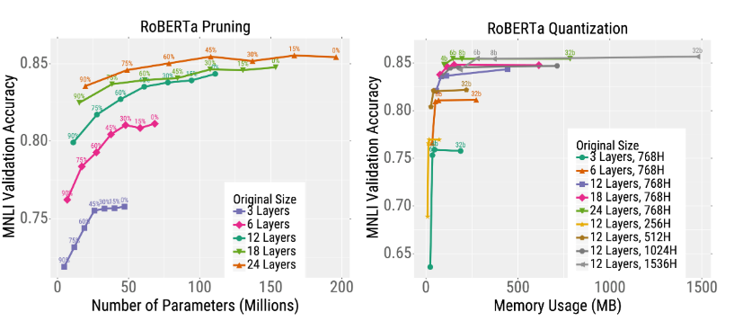
Model Selection
Not all models respond in the same way to knowledge distillation, pruning, and quantization
https://bair.berkeley.edu/blog/2020/03/05/compress/
Li, Z., Wallace, E., Shen, S., Lin, K., Keutzer, K., Klein, D., & Gonzalez, J. E. (2020). Train large, then compress: Rethinking model size for efficient training and inference of transformers. arXiv preprint arXiv:2002.11794.

Slide 13
Model Selection
Very large models are and will continue to be prevalent
10,000,000,000
Megatron-Turing NLG 530B
Transformers: 275x / 2yrs
1,000,000,000
GPT-3
Bloom
100,000,000
All AI Models: 25x / 2yrs
Microsoft T-NLG
10,0000,00
Megatron
XLNet
Wav2Vec 2.0
1,0000,00
MoCo ResNet50
Training Compute (PetaFLOPS)
Xception
1000,00
InceptionV3
BERT Large
Seq2Seq
GPT-1
100,00
VGG-19
ResNetXt
Transformer
Resnet
ELMo
DenseNet201
10,00
AlexNet
Moore’s Law: 2x / 2yrs
100
2012 2013 2014 2015 2016 2017 2018 2019 2020 2021 2022
https://developer.nvidia.com/blog/using-deepspeed-and-megatron-to-train-megatron-turing-nlg-530b-the-worlds-largest-and-most-powerful-generative-language-model

Slide 14
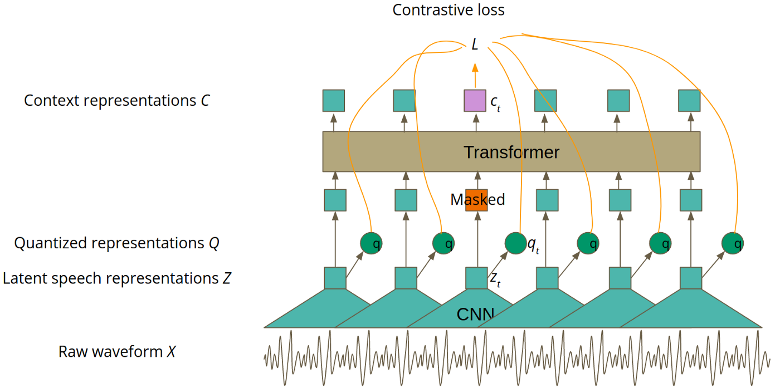
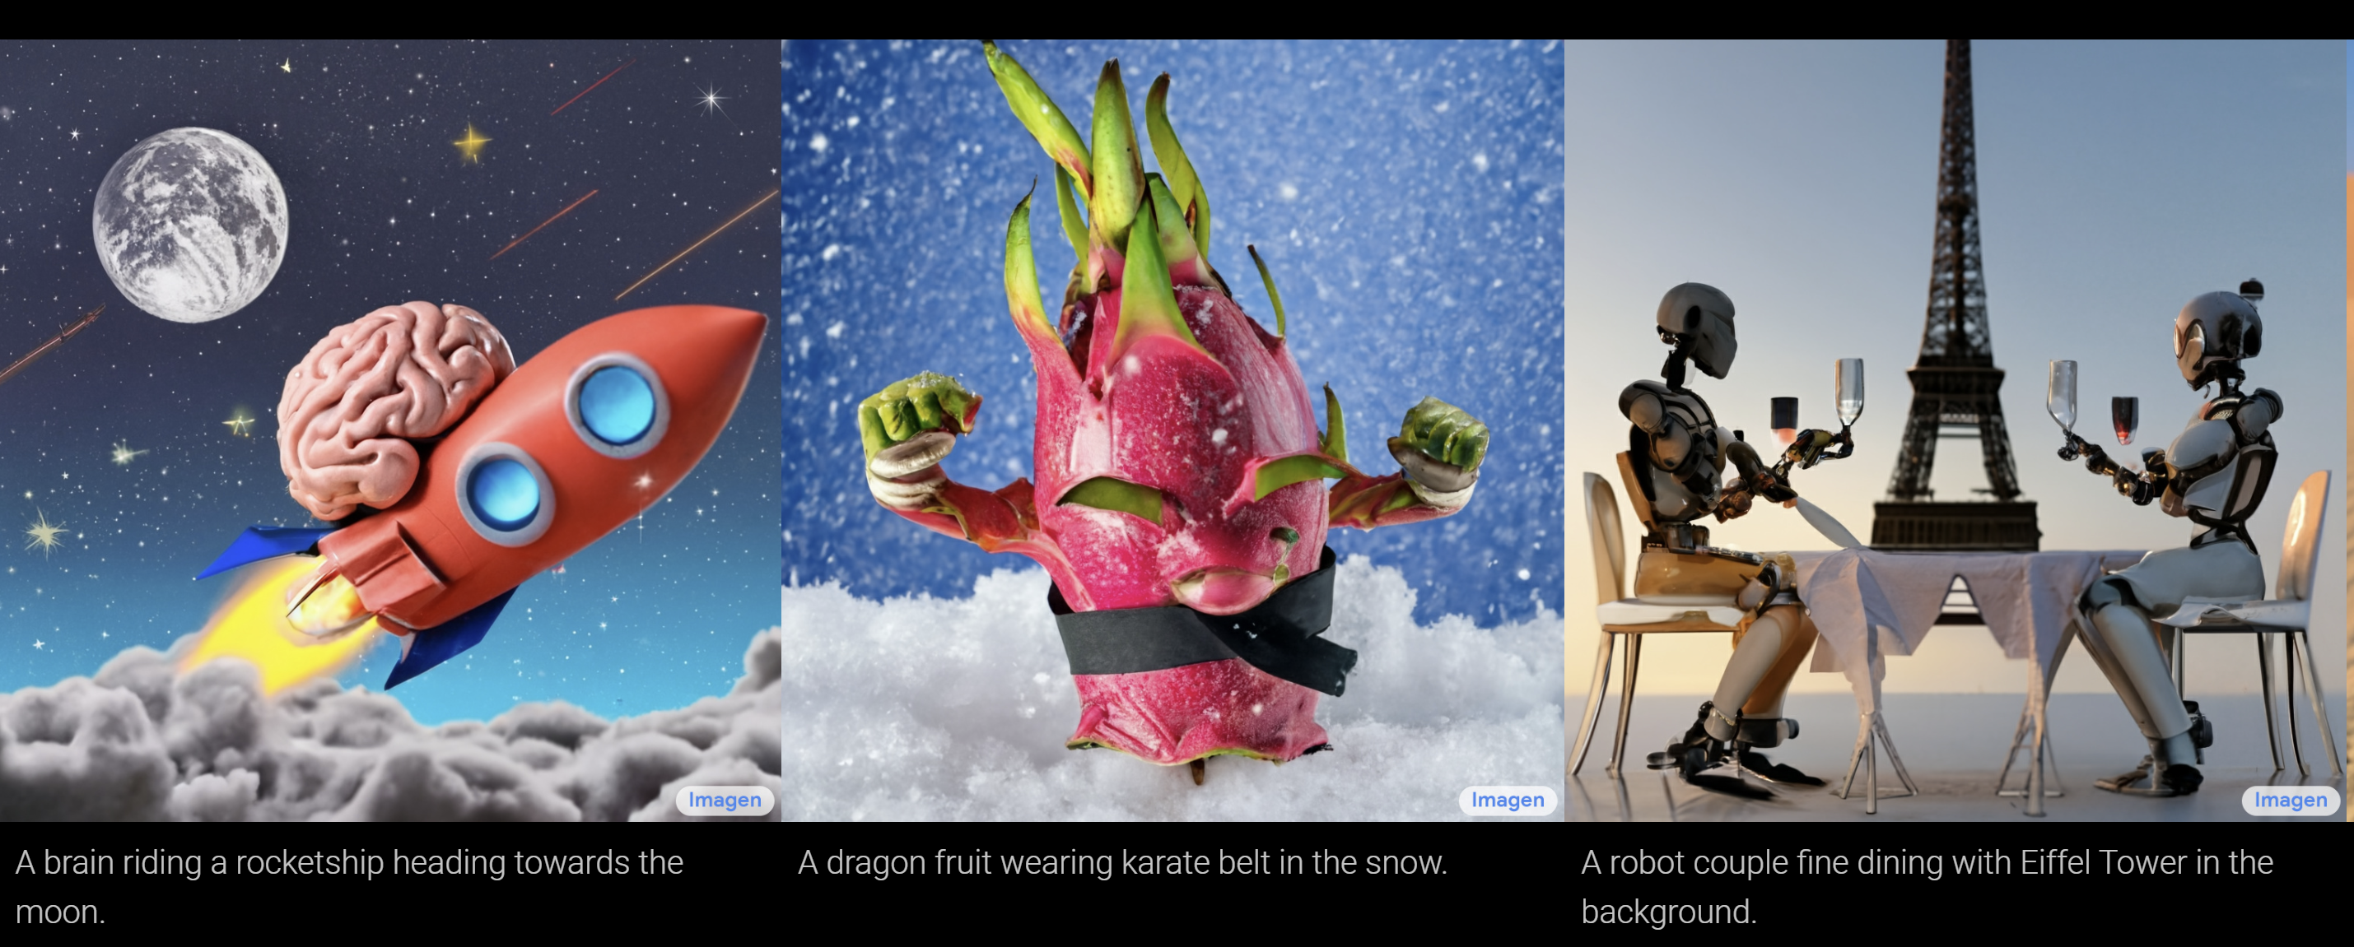
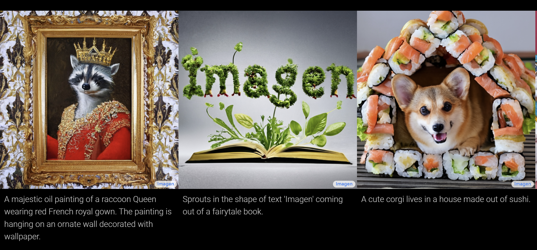
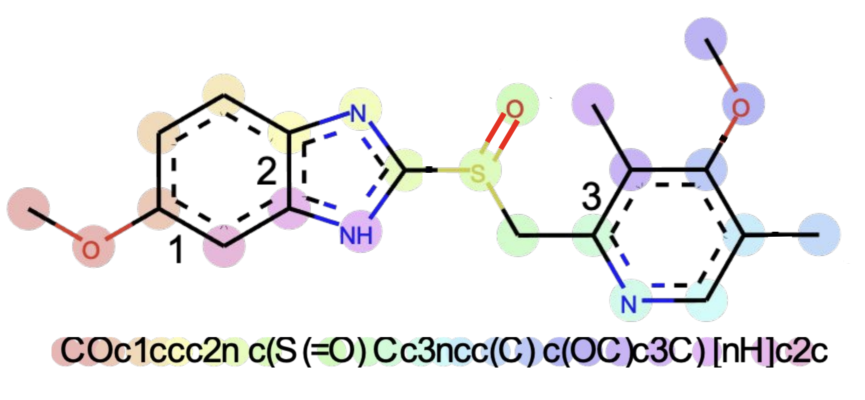
Scaling
Beyond Language
wav2vec 2.0
MegaMolBart
Imagen

Slide 15
Part 1
Deploy (Part 3)
Lecture
Beyond Model Accuracy, Meeting Application Requirements
The Right Model
The Right Implementation
Model Optimization Techniques
Beyond a Single Model
Real-World Applications
Lab
Making Kubernetes GPU-Aware
First GPU-Accelerated Application
Monitoring Your GPUs
Deploying Riva
Using Riva

Slide 16
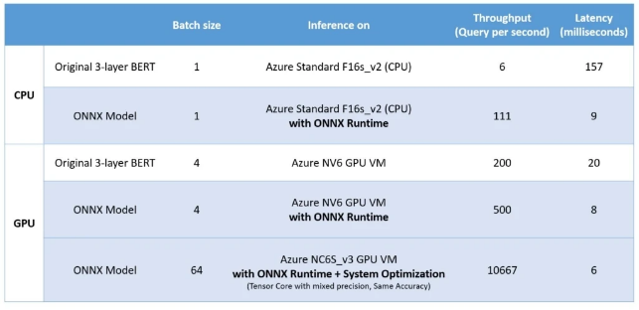
Code Quality Is Key
Dramatic differences in model performance
3-layer BERT with 128 sequence length
https://cloudblogs.microsoft.com/opensource/2020/01/21/microsoft-onnx-open-source-optimizations-transformer-inference-gpu-cpu

Slide 17
Part 1
Deploy (Part 3)
Lecture
Beyond Model Accuracy, Meeting Application Requirements
The Right Model
The Right Implementation
Model Optimization Techniques
Beyond a Single Model
Real-World Applications
Lab
Making Kubernetes GPU-Aware
First GPU-Accelerated Application
Monitoring Your GPUs
Deploying Riva
Using Riva

Slide 18
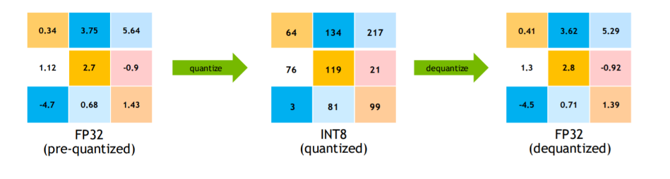
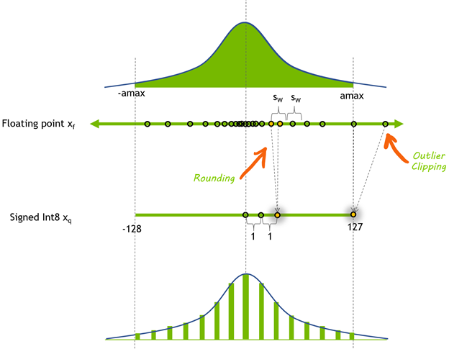
Quantization
The idea
8-bit signed integer quantization of a floating-point tensor . The symmetric dynamic range of is mapped through quantization to [-128, 127].
https://developer.nvidia.com/blog/improving-int8-accuracy-using-quantization-aware-training-and-the-tao-toolkit/

Slide 19
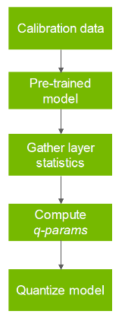
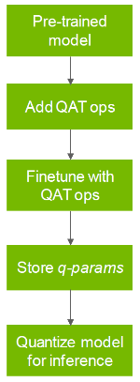
Quantization
Approaches
Post-training quantization(PTQ)
Quantization-aware training (QAT)
Post-training quantization (PTQ) |  | Quantization-aware training (QAT)
Start with a pretrained model and evaluate it on a calibration dataset. |  | Start with a pretrained model and introduce quantization ops at various layers
Calibration data is used to calibrate the model. It can be a subset of training data. |  | Fine-tune it for a small number of epochs.
Calculate dynamic ranges of weights and activations in the network to compute quantization parameters (q-params). |  | Simulates the quantization process that occurs during inference.
Quantize the network using q-params and run inference |  | The goal is to learn the q-params which can help to reduce the accuracy drop between the quantized model and pretrained model.

Slide 20
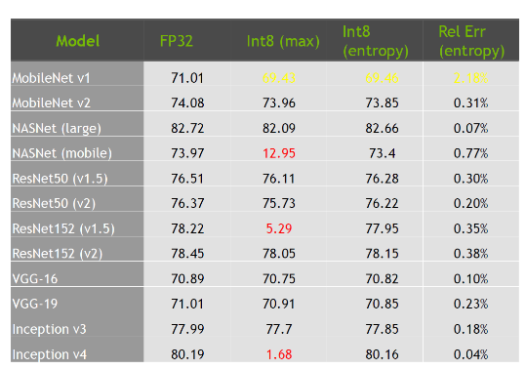
Quantization
Impact of model design

Slide 21
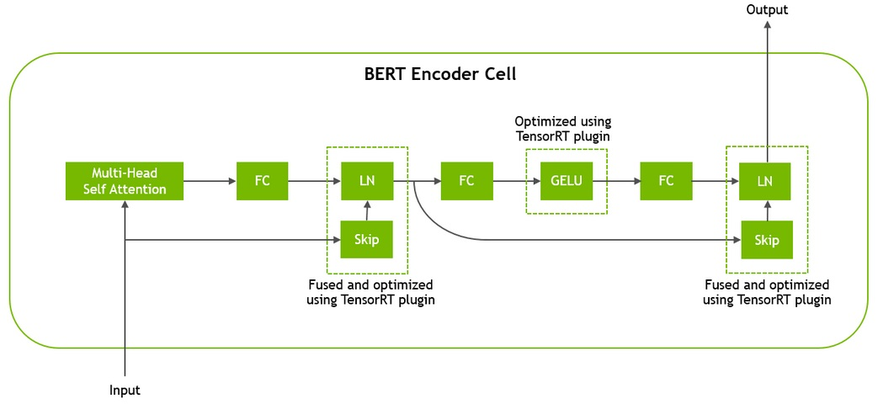
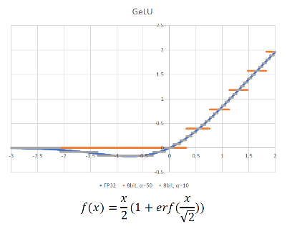
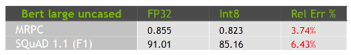
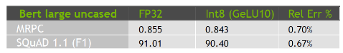
Quantization
Impact of model design
GeLU produces highly asymmetric range
Negative values between [-0.17,0]
All negative values clipped to 0
GeLU10 allows to maintain negative values

Slide 22
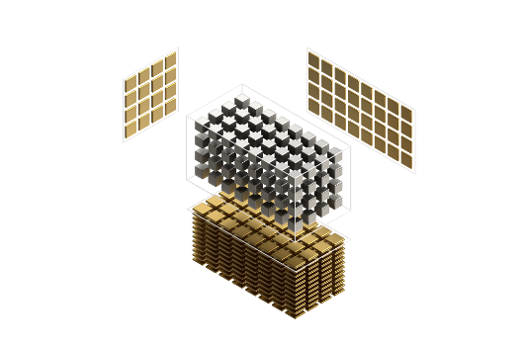
Model Pruning
The opportunity:
Reduced memory bandwidth
Reduced memory footprint
Acceleration (especially in presence of hardware acceleration)
2 step process:
1
Reduce model size
Incrementally retrain model after pruning to recover accuracy
2
6 inputs, 6 neurons, 32 connections
6 inputs, 5 neurons, 24 connections

Slide 23
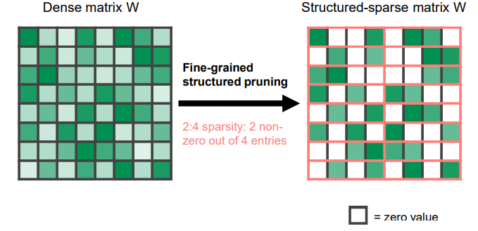
Model Pruning
Accelerate with Ampere sparse tensor core
Fine-grained structured sparsity for Tensor Cores
50% fine-grained sparsity
2:4 pattern: 2 values out of each contiguous block of 4 must be 0
Addresses the 3 challenges:
Accuracy: maintains accuracy of the original, unpruned network
Medium sparsity level (50%), fine-grained
Training: a recipe shown to work across tasks and networks
Speedup:
Specialized Tensor Core support for sparse math
Structured: lends itself to efficient memory utilization

Slide 24
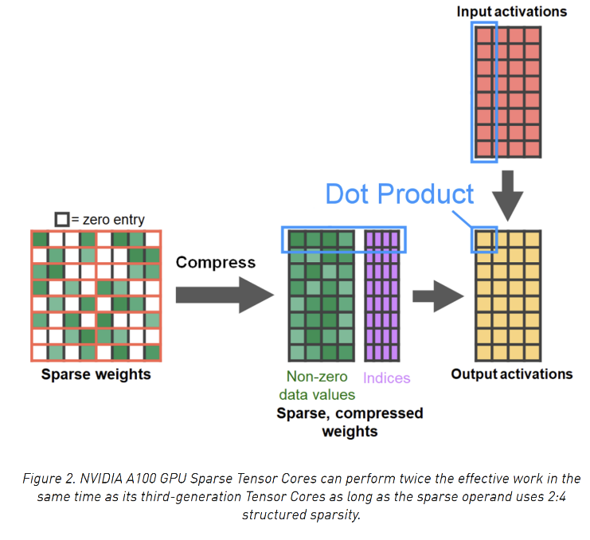
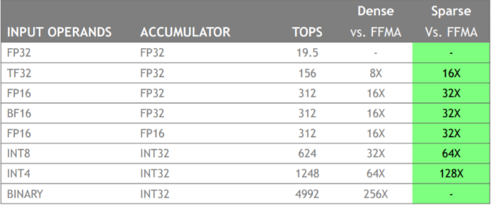
Model Pruning
Structured sparsity

Slide 25
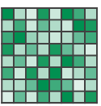
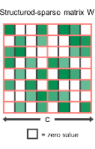
Model Pruning
Recipe for 2:4 sparse network training
Dense weights
Train (or obtain) a dense network
2:4 sparse weights
Prune for 2:4 sparsity
Repeat the original training procedure
Same hyperparameters as in step-1
Initialize to weights from step-2
Maintain the 0 pattern from step-2: no need to recompute the mask
Retrained 2:4 sparse weights

Slide 26
Bert Squad Example
SQuAD dataset and fine-tuning is too small to compensate for pruning on its own
Structured Sparsity Pruning
Pretrain Language Model
Sparse
Pretrain Language Model
Sparse
Fine-tune
SQuAD
Pretrain Language Model
Learning Rate
Fine-tune SQuAD
Learning Rate
Step 1
Step 2
Step 1
Step 4
Step 3
Step 2

Slide 27
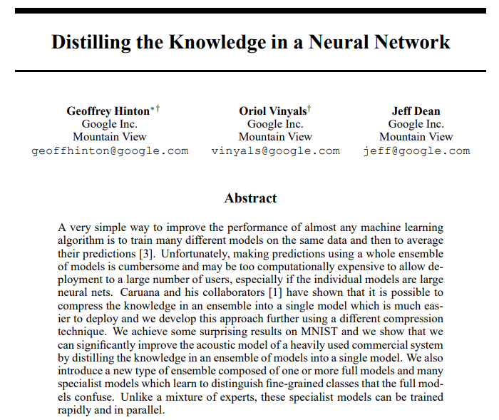
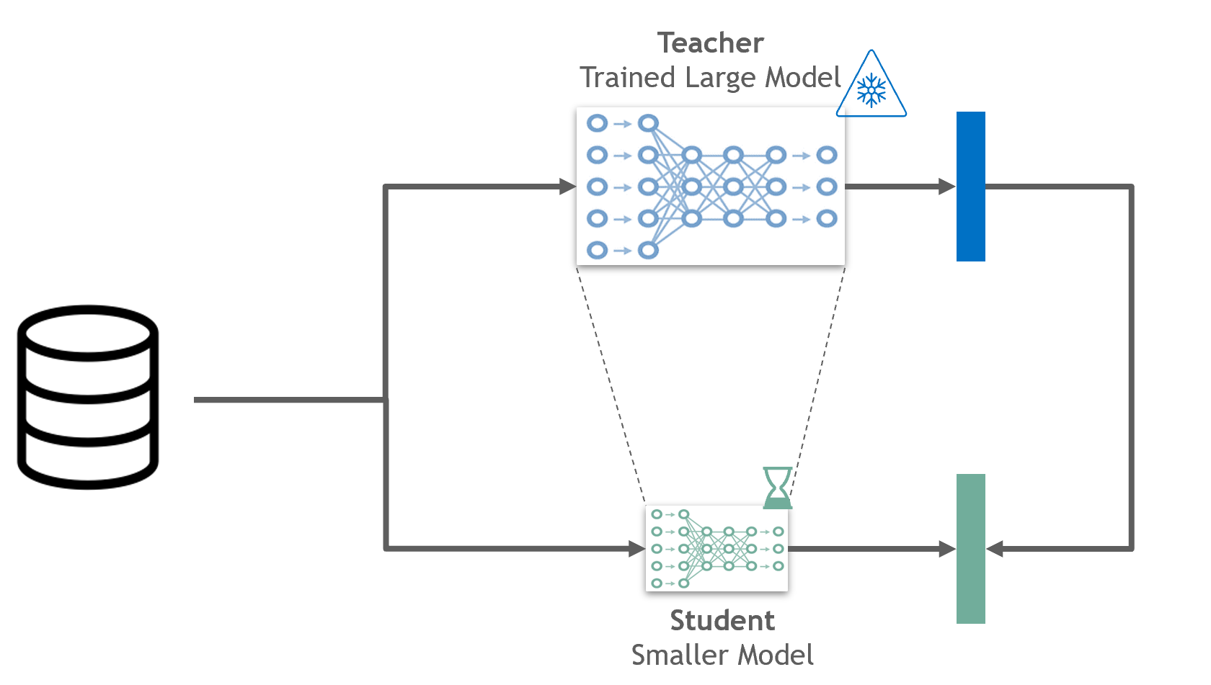
Knowledge Distillation
The idea
Notes:
Model distillation
Where a large trained model is used to teach a smaller one

Slide 28
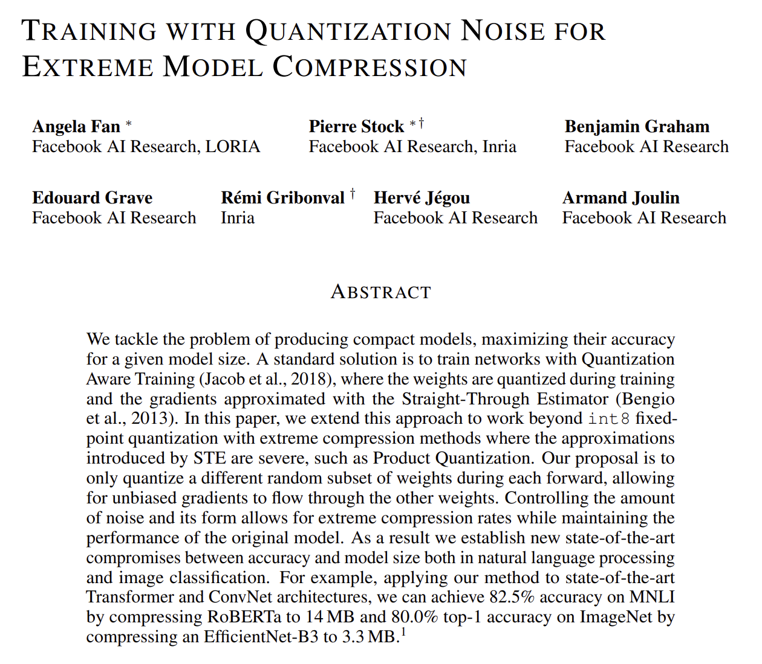
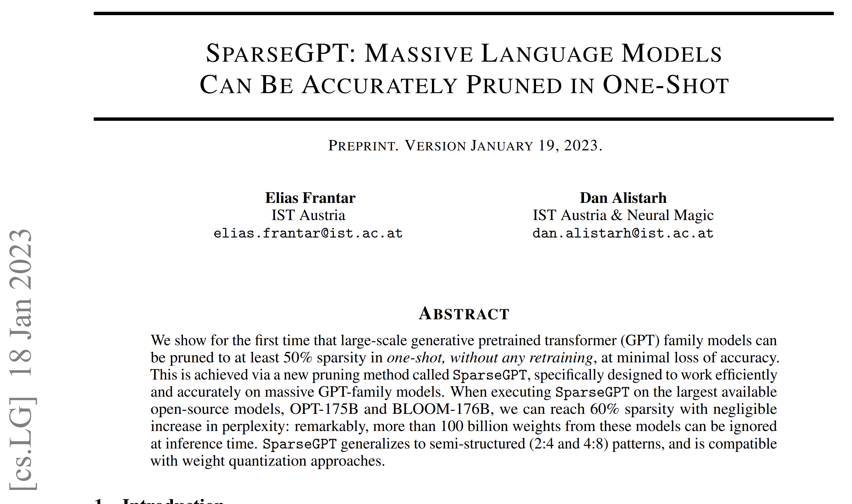
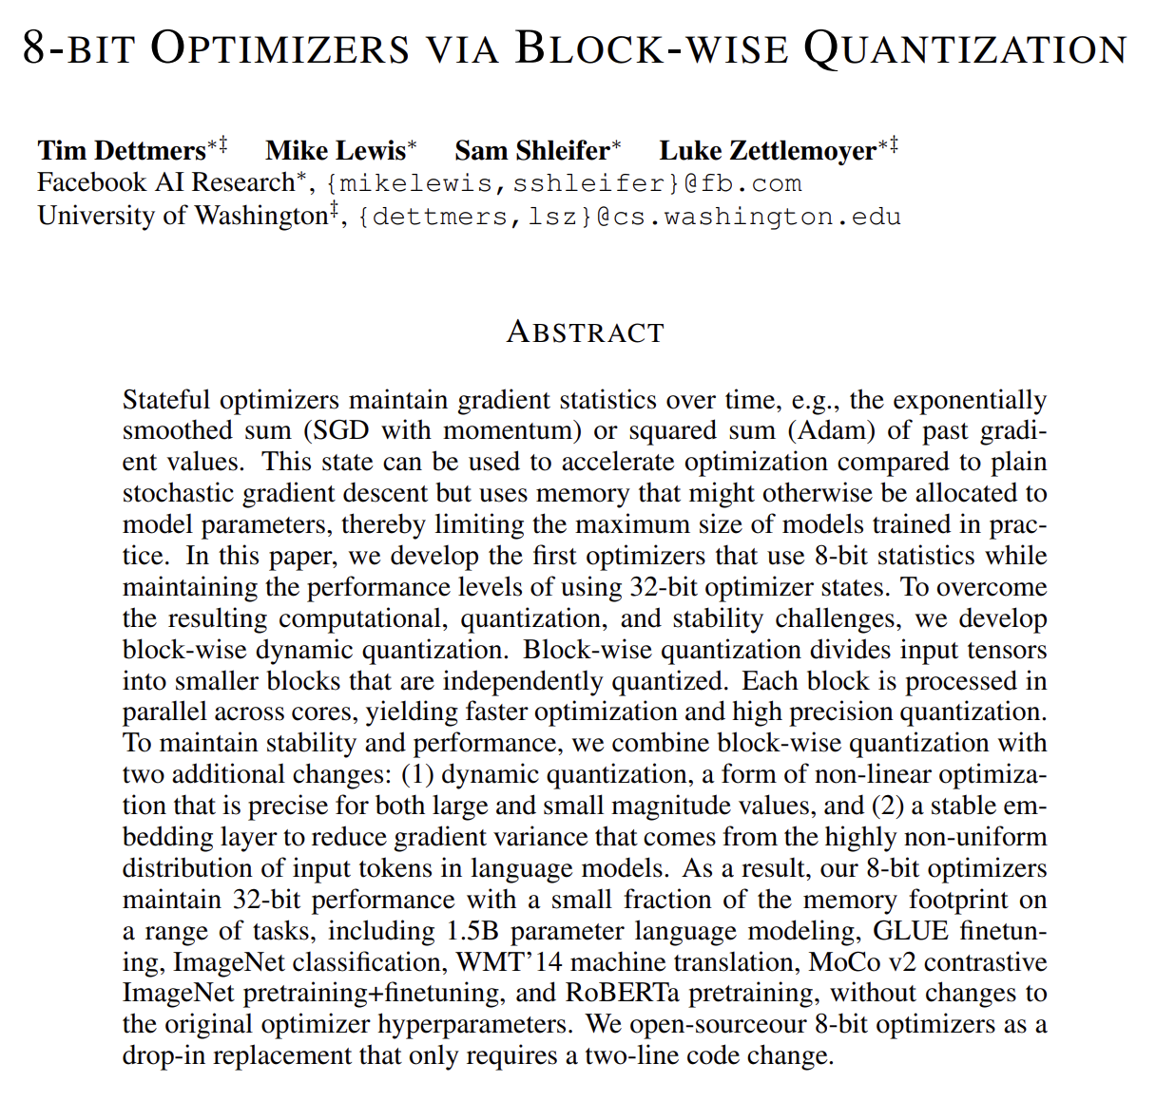
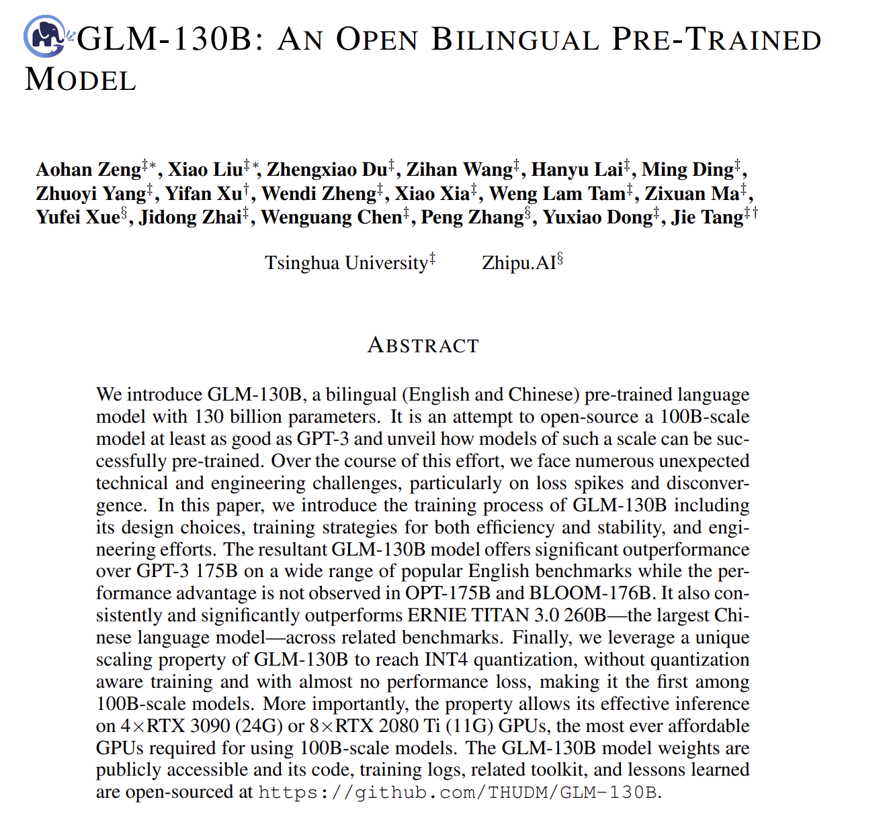
Model Optimizations
Some papers
“We used Quant-Noise to compress Facebook AI’s state-of-the-art RoBERTa Base model from 480 MB to 14 MB while achieving 82.5 percent on MNLI, compared with 84.8 percent for the original model.”

Slide 29
Choice of the Model Optimization Tool

Slide 30
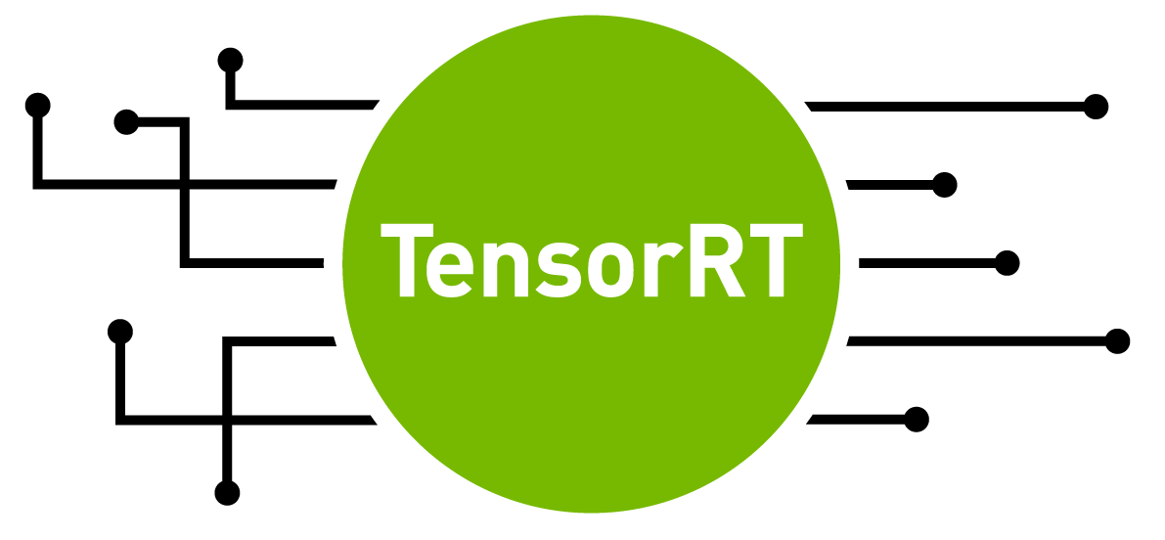
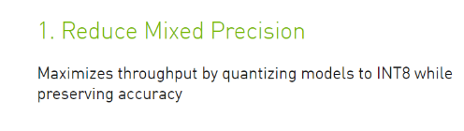
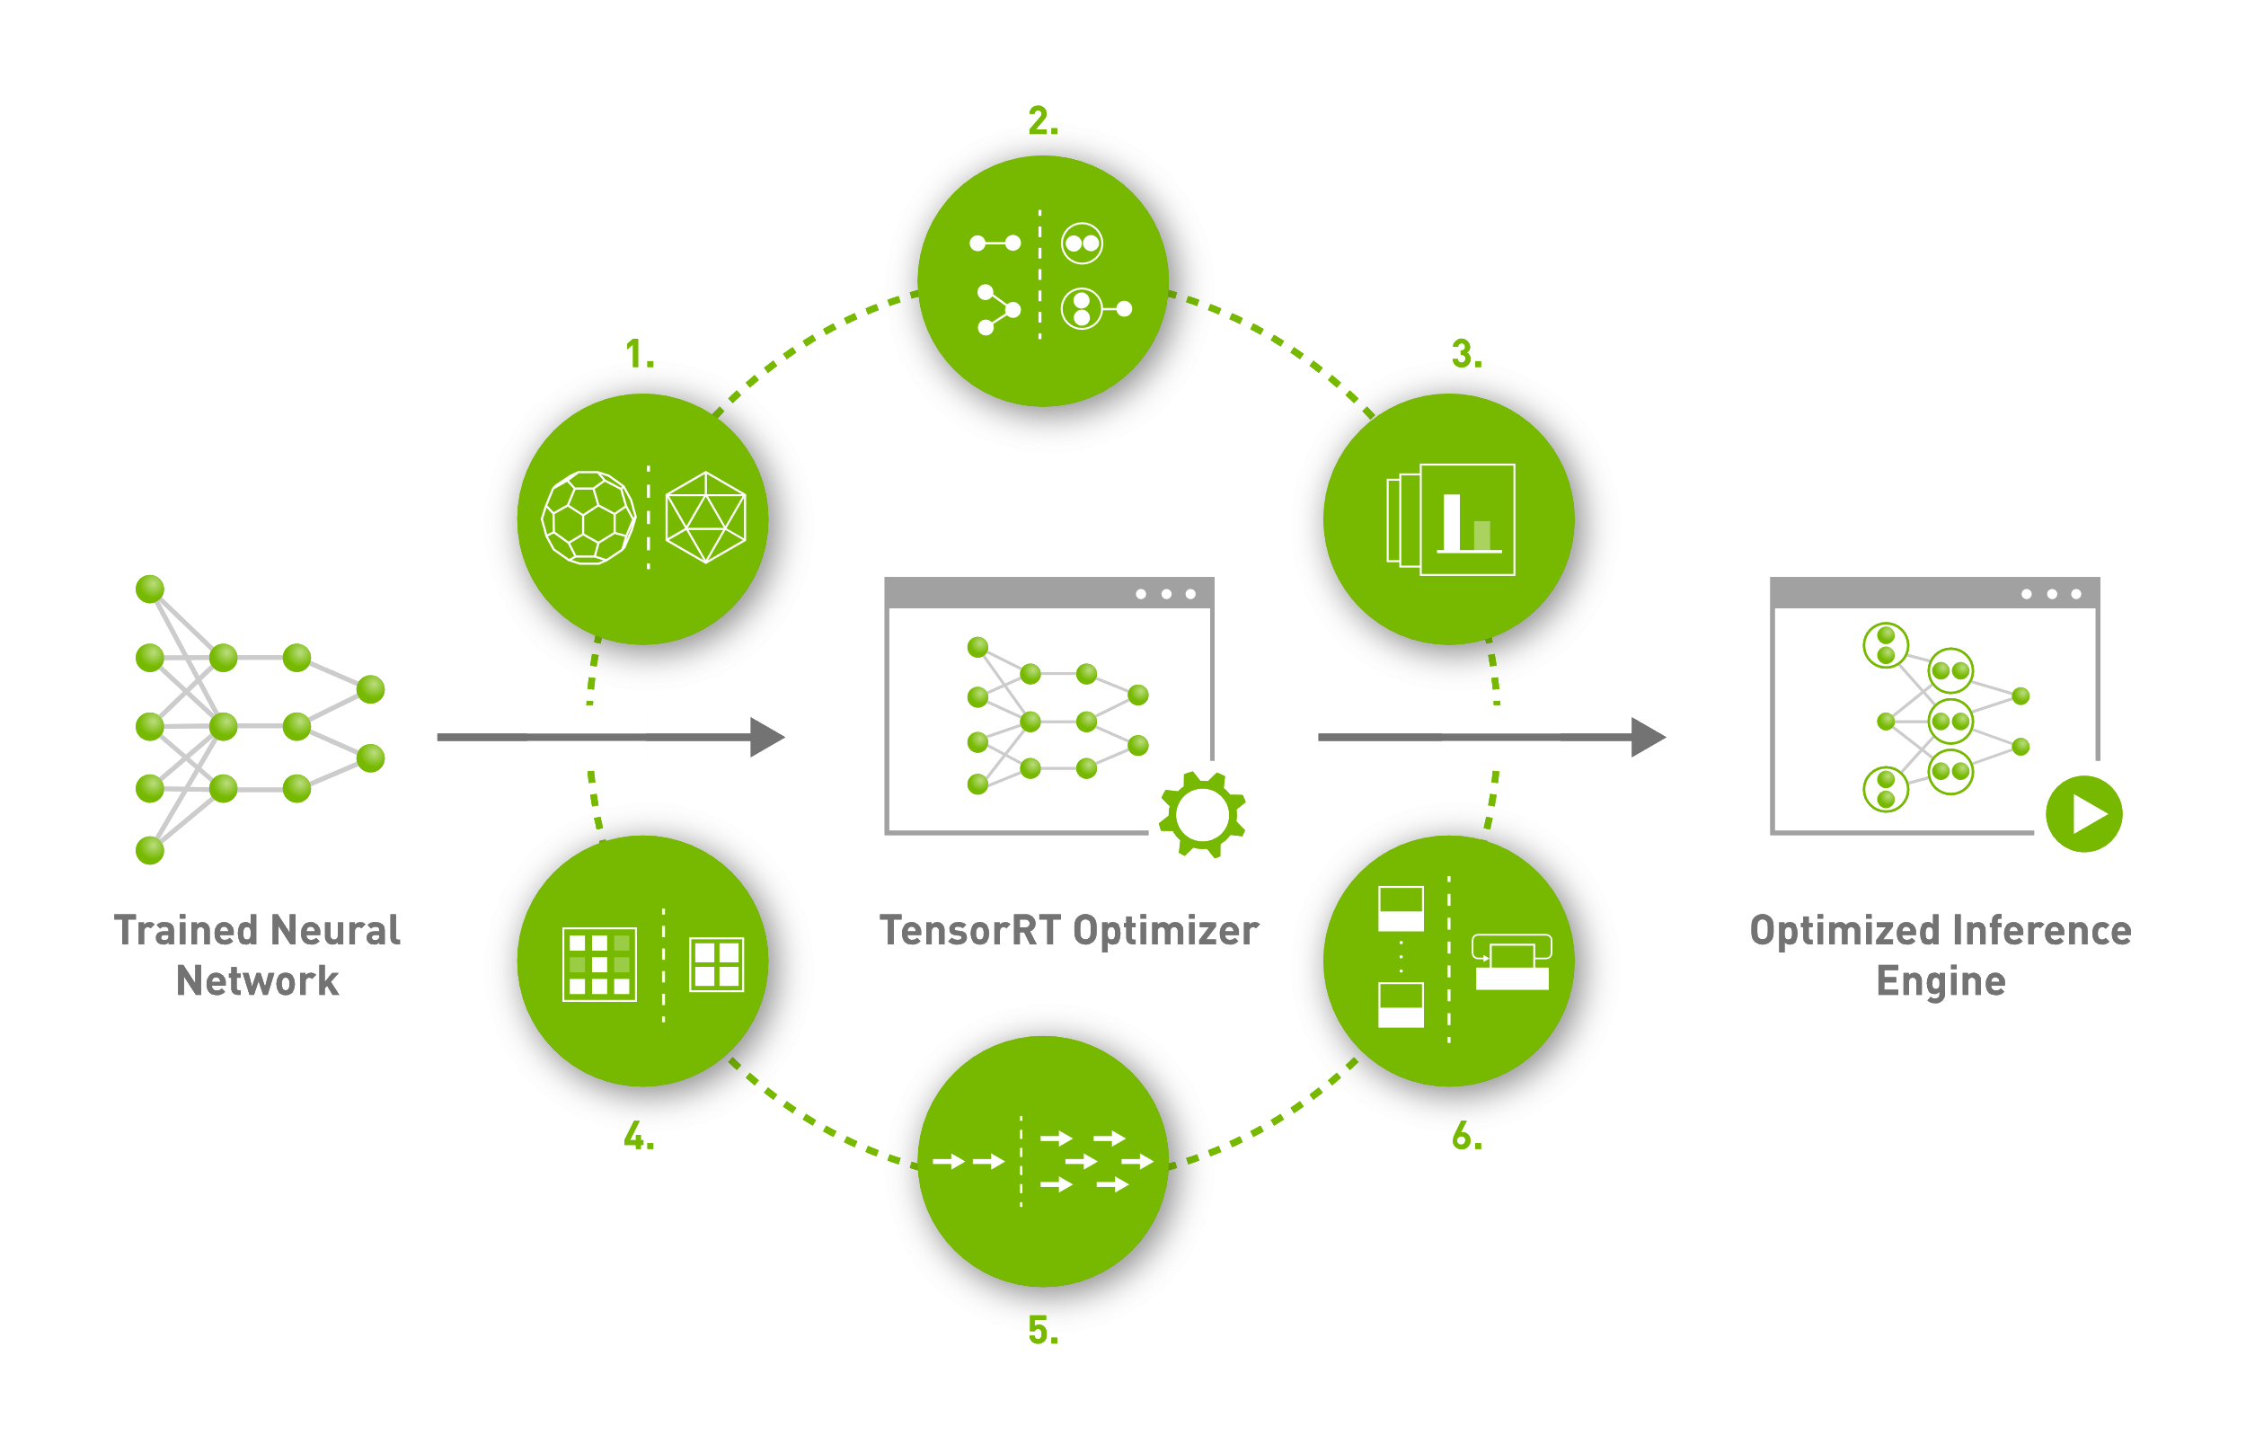
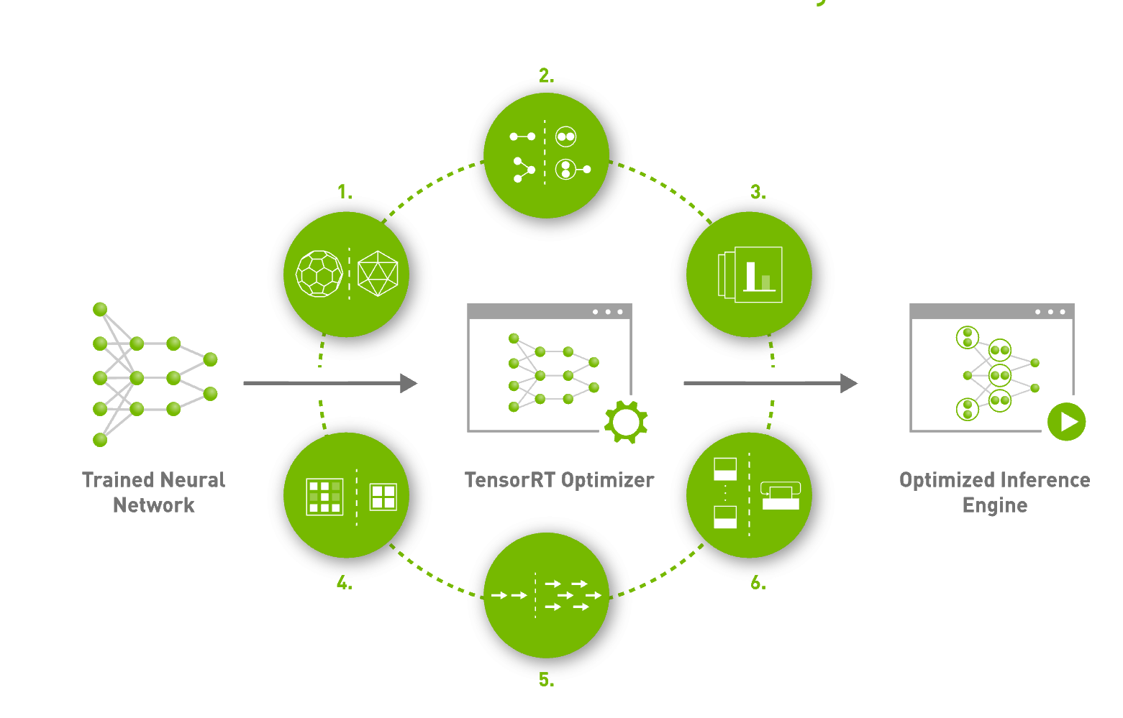
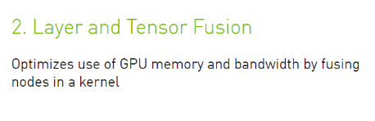
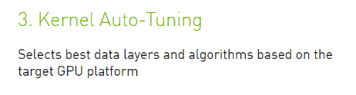
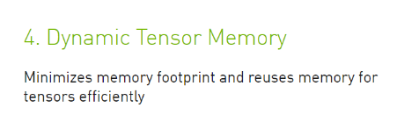
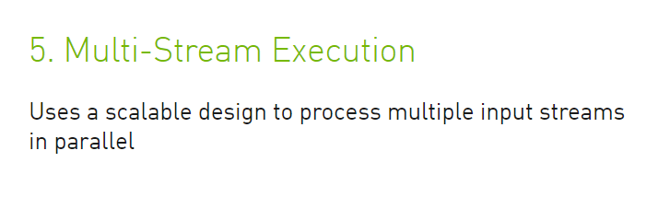
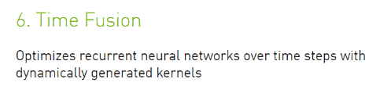
TensorRT
Key features
developer.nvidia.com/tensorrt

Slide 31
TensorRT
Layer & tensor fusion
MatMul (Q)
Transpose
MUL
Eltwise
Scale
Softmax
MatMul (K)
Transpose
Optimizes use of GPU memory and bandwidth by fusing nodes in a kernel
Combines successive nodes into a single node, making single kernel execution
Significantly reduces number of layers to compute, resulting in faster performance
Eliminates unnecessary memory traffic by removing concat/slice layers
Input
MUL
MatMul (V)
Transpose
MatMul (QKV)
Transpose
MUL
Scaled Softmax
Input
MUL
developer.nvidia.com/tensorrt
Supported fusion list

Slide 32
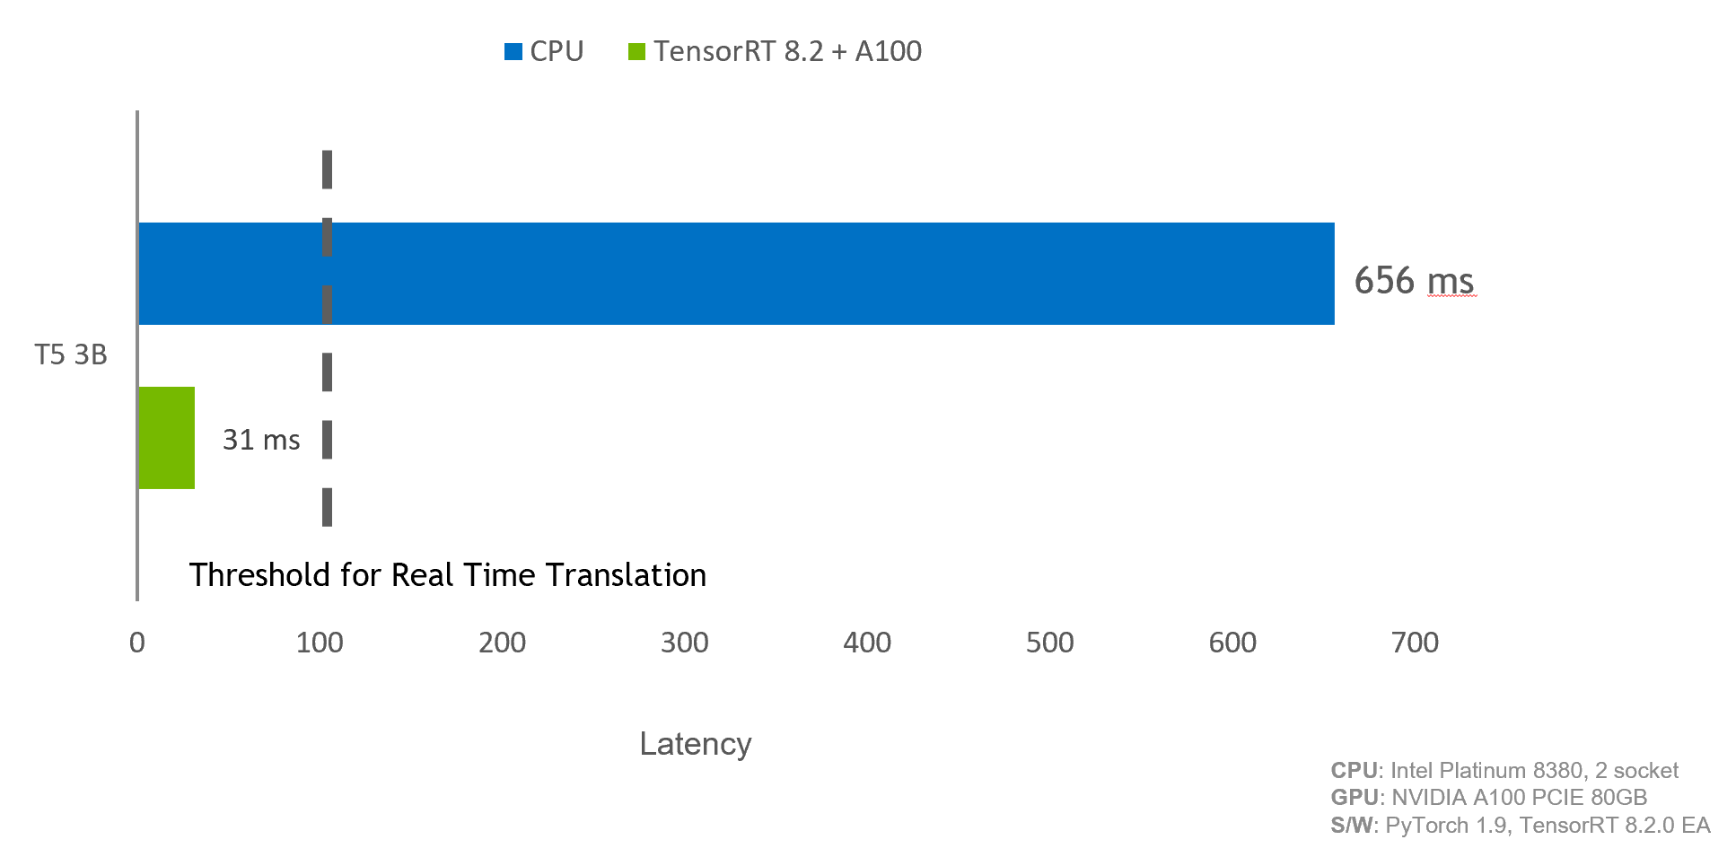
TensorRT
Transformer
T5/GPT-2 demo code in TensorRT OSS github repo

Slide 33
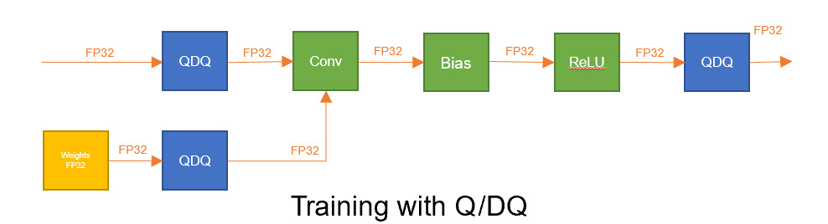
TensorRT
Quantization-aware training (QAT)
Improved accuracy for INT8 inference
Better accuracy compared to Post Training Quantization (PTQ)
Quantize state of the art models with minimal loss of accuracy
TensorRT optimizes the Q/DQ graph for inference without compromising performance
 | FP32 & FP16 | INT8 PTQ | INT8 QAT
Top-1 acc | 77.4 | 33.93 | 76.8
GPU: A100, Network: EfficientNet-B0, BS=64
https://github.com/NVIDIA/TensorRT/tree/master/tools/pytorch-quantization

Slide 34
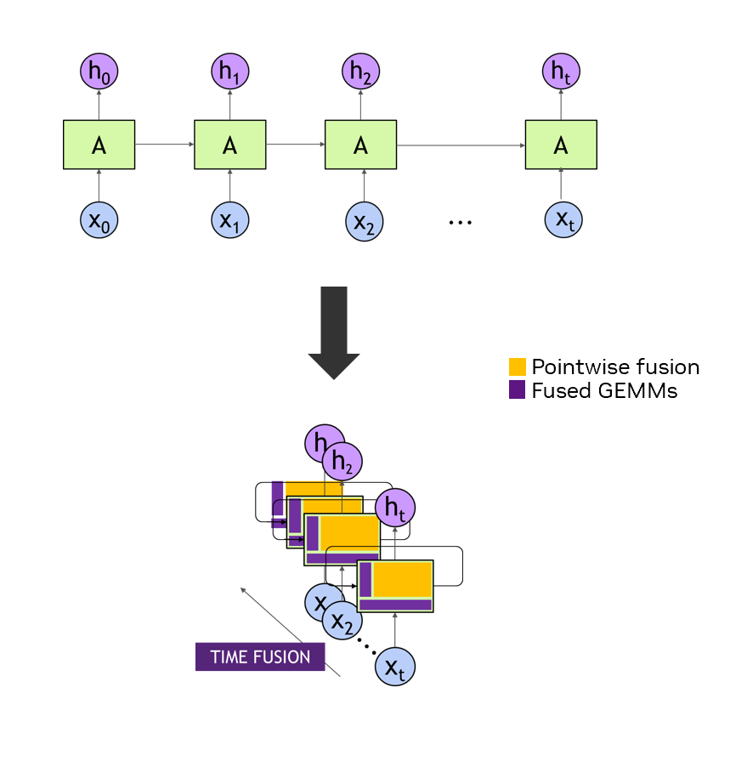
TensorRT
Recurrent neural network optimizations
Deploy highly-optimized Conversational AI apps in production environments
New API to define loops found in RNNs
Compiler fuses pointwise ops, generates optimized kernels, and fuses ops across time steps
Models Supported: Tacotron 2, WaveRNN, DeepASR, GNMT, LSTM Peephole, LSTM Autoencoder
Blog: Real Time Text-to-Speech using TensorRT

Slide 35
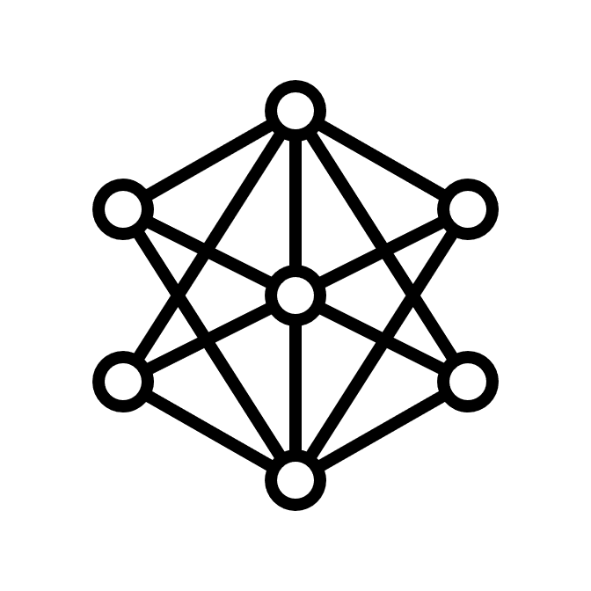





Inference Optimization Workflow for TensorRT
TensorRT
Trained DNN
ONNX Conversion
TensorRT Optimizer
TensorRT Runtime
TensorRT Framework Integrations
1 line
TensorRT Framework Integrations API
TorchScript
SavedModel
Trained DNN
Inference in-Framework
TensorRT Optimizer
TensorRT Runtime

Slide 36
Framework Integrations
Conversion workflow
Fallback to Framework
TensorRT
Engine
Native Model
1. Partition Model
2. Convert Model
Identify supported nodes
Convert nodes to TensorRT

Slide 37
TensorRT Integrated With PyTorch and TensorFlow
Up to 4X faster inference with one line of code
Torch-TensorRT
TensorFlow-TensorRT
PyTorch Logo
CTA - In container
TensorFlow Logo
CTA - In TensorFlow branch
import torch
import torch_tensorrt as torchtrt
# SET trained model to evaluation mode
model = model.eval()
# COMPILE TRT module using Torch-TensorRT
trt_module = torchtrt.compile(model, inputs=[example_input],enabled_precisions={torch.half})
# RUN optimized inference with Torch-TensorRT
trt_module(x)
import tensorflow as tf
from tf.python.compiler.tensorrt import trt_convert as tftrt
# COMPILE TRT module using TensorFlow-TensorRT
trt_module = tftrt.TrtGraphConverterV2(saved_model_pth).convert()
# RUN optimized inference with TensorFlow-TensorRT
trt_module(x)
Available in PyTorch & NGC Container
Available in TensorFlow & NGC Container

Slide 38
Sparsity Support
APEX automatic sparsity - TensorRT
ASP (Automatic SParsity) provides easy-to-use workflow to induce the sparsity while maintaining accuracy of original dense network
TensorRT accelerates inference using sparse kernels
Training Phase
# Import ASP (Automatic SParsity)
from apex.contrib.sparsity import ASP
# In training phase, to augment the model and the optimizer #for sparse training/inference
ASP.prune_trained_model(model, optimizer)
Inference Phase
Enable Sparsity by setting the kSPARSE_WEIGHTS flag in IBuilderConfig
ASP: https://github.com/NVIDIA/apex/tree/master/apex/contrib/sparsity

Slide 39













TensorRT
Widely adopted
2.5M
Downloads
350K+
Developers
Conversational AI
Healthcare
600+
Inference Services
Automotive
Finance
Growing Ecosystem
3X developers in 2020 vs. 2019
Customers
Trusted by 27,500 Companies
Cloud to Edge Delivers across Industries

Slide 40
Part 1
Deploy (Part 3)
Lecture
Beyond Model Accuracy, Meeting Application Requirements
The Right Model
The Right Implementation
Model Optimization Techniques
Beyond a Single Model
Real-World Applications
Lab
Making Kubernetes GPU-Aware
First GPU-Accelerated Application
Monitoring Your GPUs
Deploying Riva
Using Riva

Slide 41

Build the Application
Deploy several neural networks

Slide 42



Challenges In Model Deployment
Ease of Use
Cost of Deployment
Ecosystem Tools
Multiple Frameworks
Requires Retooling In Production
Different Types Of Use Cases:
Real Time, Batch, Streaming, Ensembles
Each Requires Serving Optimizations
Need For Mixed Infrastructure -
CPU & GPU on Cloud, Data Center & Edge
Disparate Serving Solutions Increase Cost
High Performance, Low Latency Inference on GPU and CPU
Hardware Underutilization Increases Cost
Scaled Deployment Needs Cluster Orchestration Tools
Lack of Integration w/ Standard Tools Drives Costly/Non-scalable Implementations
Notes:
Low latency, high throughput and reduce the cost
We need serving tools supporting different frameworks, model ensemble, different machines, updates without disrupting the application

Slide 43










Nvidia Triton Inference Server
Triton takes care of plumbing to deploy models for inference
Standardized Inference Platform
Inferencing on GPU and CPU
Different Types of Queries
Maximized Hardware Utilization
Custom
Backends
GPU
CPU
(Random Forest)
(For non-categorical features)
Real time
Batch
Stream
Ensemble
Support for All Major Framework Backends for Flexibility & Consistency
Standard HTTP, gRPC, and C++ Communication
Inference Serving on GPU, CPU, and Mixed Workloads
Cloud | Data Center | Edge
Bare metal | Virtualization
Support for Different Types of Inference Queries and Use Cases
Concurrent Model Execution Increases Throughput & Utilization, lowering TCO
Dynamic Batching Maximizes Throughput Under Latency Constraint

Slide 44

Nvidia Triton Inference Server
Triton integrates easily in organization workflows for all ai use cases
Kubernetes Integration
MLOps
Open Source & Customizable
Scalable Microservice In Kubernetes
Helm Chart For Fast Deployment
KFServing Integration
Live Model Updates | Dynamic Model Loading | Triton Model Analyzer
Integrated with Azure ML, Seldon, ClearML, and AWS SageMaker and Google CAIP as Custom Container
Completely Open Source – Inspect, Customize & Extend
Customizable Container –Modular Backends For Low Memory Footprint

Slide 45


Nvidia Triton Inference Server
Dynamic batching scheduler
Triton Inference Server
Framework Backend
Runtime
Batch-1 Request
Batch-4 Request
Context
Dynamic Batcher
Context

Slide 46

Nvidia Triton Inference Server
Streaming inference requests
Streaming API
Based on the correlation ID, the audio requests are sent to the appropriate batch slot in the sequence batcher*
*Correct order of requests is assumed at entry into the endpoint
Note: Corr = Correlation ID

Slide 47

Nvidia Triton Inference Server
Model ensembling
Pipeline of one or more models and the connection of input and output tensors between those models
Use for model stitching or data flow of multiple models such as data preprocessing → inference → data post-processing
Collects the output tensors in each step, provides them as input tensors for other steps according to the specification
Ensemble models will inherit the characteristics of the models involved, so the meta-data in the request header must comply with the models within the ensemble
Notes:
Useful when complex developing pipelines. Mixed (CPU/GPU)
It allows to minimize memory copy, by mutualizing some processes
Avoid memory copy if not necessary

Slide 48

Nvidia Triton Inference Server
Model analyzer
Tool to automatically identify optimal model configurations to maximize performance
Specify constraints on performance results, latency and throughput
Model Analyzer automatically sweeps through different configurations (batch sizes, model instances, etc.)
Finds the best configuration for optimal performance under constraints
Analyze results through reports and charts
GitHub repo and docs: https://github.com/triton-inference-server/model_analyzer

Slide 49


















Nvidia Triton Inference Server
Broad use cases and integrations
Adoption
Publicly Referenceable
Success Stories
Platform Integrations
Amazon EKS
Azure AKS
Azure Machine Learning
Fraud Detection
Fraud Detection*
Image Classification & Recommendation
Google GKE
Google Vertex AI Custom Container
Grammar Check
Image Segmentation
Defect Detection
Kubeflow/KFServing
Prometheus
Video Content Audit
Product Identification
Package Analytics
Notes:
.

Slide 50


NVIDIA Riva
Uses TensorRT and Triton Inference Server
Notes:
Riva under the hood: TensorRT and Triton Inference Server

Slide 51
Part 1
Deploy (Part 3)
Lecture
Beyond Model Accuracy, Meeting Application Requirements
The Right Model
The Right Implementation
Model Optimization Techniques
Beyond a Single Model
Real-World Applications
Lab
Making Kubernetes GPU-Aware
First GPU-Accelerated Application
Monitoring Your GPUs
Deploying Riva
Using Riva

Slide 52





Real-World Applications Challenges
Authentication | scaling | monitoring
Application: N
Version: K

Slide 53




Real-World Applications Challenges
Authentication | scaling | monitoring
Pipeline Monitoring Statistics
Authentication Service
RIVA ASR
Speech
Text
Load Balancer
Dialog Manager
Speech
Speech
Virtual Assistant
RIVA TTS
Speech
Text
Orchestration Cluster | Storage
Notes:
Here is an example of Virtual Assistant Application in commercial setting.

Slide 54

Real-World Applications Challenges
Authentication | scaling | monitoring
RIVA ASR
Speech
Text
Client
Speech
Text
NLP
RIVA TTS
Speech
Text
Speech
Kubernetes Cluster
Notes:
Here is an example of Virtual Assistant Application in commercial setting.

Slide 55
Monitoring
Telemetry
Telemetry:
Involves automatically collecting and analyzing data received from a distance
Measure physical quantities; hardware counters; and software specific metrics
Related to logging used to more in depth diagnose errors and examine state flows
Why?
Identify bottlenecks in the pipeline
Alert notifications (out of memory, thread trashing, swapping, …)
Calculating and measuring utilization
Notes:
Typically, it has a mechanism to collect, centralizes and store the metrics.
An Alertmanager to trigger alerts based on those metrics. That could raise problems, send emails
And a data viz and export wit dashboard

Slide 56






Monitoring
Data center GPU manager - DCGM
GPU
Utilization
for capacity planning
Tensor core Utilization
for higher app performance
Memory & Bandwidth Usage
for optimal app performance
NVLink/PCIe Usage
for optimal app performance
GPU Power consumption
for GPU health
GPU Temperature
for GPU health
GPU
errors
for GPU health
NVIDIA DCGM
7 GPU METRICS TO MONITOR FOR HIGHER AVAILABILITY, UTILIZATION & APPLICATION PERFORMANCE

Slide 57







Monitoring
DCGM integration with monitoring tools
GPU metrics from DCGM can be exported into Prometheus, Kubernetes, collectd & Telegraf monitoring/metrics
Easy visualization e.g. Grafana Prometheus/collectd
DCGM available for GPUs on-premises data center and public clouds
Visualization via Prometheus & Grafana
DCGM
Visualization via collectd & Grafana

Slide 58

Monitoring
General dashboard

Slide 59
Monitoring
Riva Metric Examples
Metric name | Metrics formula | Definition
Average queue time | avg(delta(nv_inference_queue_duration_us[1m])/(1+delta(nv_inference_request_success[1m]))/1000) | Time in milliseconds a request stays in the Triton Inference Server queue averaged over all the requests in a one-minute time window. This is a measure of your server’s computing capability; if this increases over a threshold, consider scaling your server to more replicas
Number of successful requests per minute | sum(delta(nv_inference_request_success[1m])) | Total number of successful inference requests captured over a one minute time window
Number of failed requests per minute | sum(delta(nv_inference_request_failure[1m])) | Total number of successful inference requests captured over a one minute time window
P99 latency is seconds | quantile_over_time(0.99, nv_inference_compute_infer_duration_us[1m]) / 1000 / 1000 | The p99 ASR latency of all the request samples captured over a one minute time window
P95 latency is seconds | quantile_over_time(0.95, nv_inference_compute_infer_duration_us[1m]) / 1000 / 1000 | The p95 ASR latency of all the request samples captured over a one minute time window
GPU memory utilization | avg(nv_gpu_memory_used_bytes / 1024 / 1024 / 1024) | GPU memory used by the Riva server
Number of Riva Servers | count (count by (instance) (nv_cache_hit_lookup_duration_per_model)) | Riva server replicas on the Kubernetes cluster.
GPU Utilization | avg(nv_gpu_utilization) | Average GPU utilization
GPU Power Utilization | avg(nv_gpu_power_usage) | GPU power consumption over a period of time

Slide 60
Part 1
Deploy (Part 3)
Lecture
Beyond Model Accuracy, Meeting Application Requirements
The Right Model
The Right Implementation
Model Optimization Techniques
Beyond a Single Model
Real-World Applications
Lab
Making Kubernetes GPU-Aware
First GPU-Accelerated Application
Monitoring Your GPUs
Deploying Riva
Using Riva

Slide 61

Lab Overview
Deploy a Kubernetes cluster and make Kubernetes GPU-Aware
First GPU-accelerated application
Deploy Riva ASR and TTS on the Kubernetes cluster
Request Riva services from Kubernetes cluster
Monitoring your Application with Prometheus and Grafana,
Riva provides Prometheus metrics indicating GPU and request statistics in plain text. Metrics exposed on server:8002/metrics.
Metrics are viewed using a sample Grafana dashboard.

Slide 62
Lab

